Slide 1
Time complexity of Sorting
Several sorting algorithms have been discussed and the best ones, so far:
  Heap sort and Merge sort: O( n log n )
  Quick sort (best one in practice): O( n log n ) on average, O( n2 ) worst case

Slide 2
4319, 4628, 9329, 8618, 9615, 4595,
35, 129, 328, 115

Slide 3
Time complexity of Sorting
Can we do better than O( n log n )?
  No.
  It can be proven that any comparison-based sorting algorithm will need to carry out at least O( n log n ) operations

Slide 4
Can we do better?
Linear sorting algorithms
  Bucket sort
  Radix Sort
  Counting Sort
Make certain assumptions about the data
Linear sorts are NOT “comparison sorts”

Slide 5
BinSort(not binary)
(a.k.a. BucketSort)
If all keys are 1…K
Have array of size K
Put keys into correct bin (cell) of array

Slide 6
BinSort example
K=5. list=(5,1,3,4,3,2,1,1,5,4,5)
Bins in array
key = 1 | 1,1,1
key = 2 | 2
key = 3 | 3,3
key = 4 | 4,4
key = 5 | 5,5,5
Sorted list:
1,1,1,2,3,3,4,4,5,5,5

Slide 7
BinSort Pseudocode
procedure BinSort (List L,K)
LinkedList bins[1..K]
{ Each element of array bins is linked list.
Could also do a BinSort with array of arrays. }
For Each number x in L
bins[x].Append(x)
End For
For i = 1..K
For Each number x in bins[i]
Print x
End For
End For

Slide 8
BinSort Conclusion:
K is a constant
  BinSort is linear time
K is large (e.g. 2³²)
  Impractical

Slide 9
BinSort is “stable”
Stable Sorting algorithm.
  Items in input with the same key end up in the same order as when they began.
  Important if keys have associated values
  Critical for RadixSort

Slide 10
Time complexity
Bucket initialization: O( m )
From array to buckets: O( n )
From buckets to array: O( n )
  Even though this stage is a nested loop, notice that all we do is dequeue from each bucket until they are all empty –> n dequeue operations in all

Slide 11
Time complexity
Since m will likely be small compared to n, Bucket sort is O( n )
Strictly speaking, time complexity is O ( n + m )

Slide 12
Sorting integers
Can we perform bucket sort on any array of (non-negative) integers?
  Yes, but note that the number of buckets will depend on the maximum integer value
If you are sorting 1000 integers and the maximum value is 999999, you will need 1 million buckets!
  Time complexity is not really O( n ) because m is much > than n. Actual time complexity is O( m )
Can we do better?

Slide 13
Radixes
The word "radix" is used as a synonym for "base".
A radix-R representation is the same as a base-R representation.
For example:
  What is a radix-2 representation?
  What is a radix-10 representation?
  What is a radix-16 representation?

Slide 14
Radixes
The word "radix" is used as a synonym for "base".
A radix-R representation is the same as a base-R representation.
For example:
  What is a radix-2 representation? Binary.
  What is a radix-10 representation? Decimal.
  What is a radix-16 representation? Hexadecimal.
  We often use radixes that are powers of 2, but not always.

Slide 15
Radix sort
Two versions
  MSD Radix sort – Most Significant Digit
  LSD Radix sort – Least Siginificant Digit

Slide 16
MSD Radix Sort
If the radix is R, the first pass of radix sort works as follows:
  Create R buckets.
  In bucket M, store all items whose most significant digit (in R-based representation) is M.
  Reorder the array by concatenating the contents of all buckets.
In the second pass, we sort each of the buckets separately.
  All items in the same bucket have the same most significant digit.
  Thus, we sort each bucket (by creating sub buckets of the bucket) based on the second most significant digit.
We keep doing passes until we have used all digits.

Slide 17
Example
Example: suppose our items are 3-letter words:
  cat, dog, cab, ate, cow, dip, ago, cot, act, din, any.
Let R = 26.
This means that we will be creating 26 buckets at each pass.
What would be the "digits" of the items, that we use to assign them to buckets?

Slide 18
Example
Example: suppose our items are 3-letter words:
  cat, dog, cab, ate, cow, dip, ago, cot, act, din, any.
Let R = 26.
This means that we will be creating 26 buckets at each pass.
What would be the "digits" of the items, that we use to assign them to buckets?
What will the buckets look like after the first pass?

Slide 19
Example
Example: suppose our items are 3-letter words:
  cat, dog, cab, ate, cow, dip, ago, cot, act, din, any.
What will the buckets look like after the first pass?
Bucket 'a' = ate, ago, act, any.
Bucket 'c' = cat, cab, cow, cot.
Bucket 'd' = dog, dip, din.
All other buckets are empty.
What happens at the second pass?

Slide 20
Example
What happens at the second pass?
Recursively do MSD Radix on each non empty bucket.
Bucket 'a' = ate, ago, act, any.
  subbucket 'c' = act.
  subbucket 'g' = ago.
  subbucket 'n' = any.
  subbucket 't' = ate.
Bucket 'a' is rearranged as act, ago, any, ate.
Repeat same for bucket ‘c’ and bucket ‘d’

Slide 21
Programming MSD Radix Sort
Sort numbers on most-significant-digit (MSD)
  Initialise R bucket
  For eaach MSD put the number In bucket
  sort each of the resulting bins recursively
  then, combine the bins in order

Slide 22
Radix sort - LSD
Idea: repeatedly sort by digit—perform multiple bucket sorts on S starting with the rightmost digit
If maximum value is 999999, only ten buckets (not 1 million) will be necessary
Use this strategy when the keys are integers, and there is a reasonable limit on their values
  Number of passes (bucket sort stages) will depend on the number of digits in the maximum value

Slide 23
Example: 1st pass
12 | 58 | 37 | 64 | 52 | 36 | 99 | 63 | 18 | 9 | 20 | 88 | 47
20
12 52
63
64
36
37 47
58
1888
99
9
20 | 12 | 52 | 63 | 64 | 36 | 37 | 47 | 58 | 18 | 88 | 99 | 9

Slide 24
Example: 2nd pass
20 | 12 | 52 | 63 | 64 | 36 | 37 | 47 | 58 | 18 | 88 | 99 | 9
9
12
18
20
3637
47
52 58
63
64
88
99
9 | 12 | 18 | 20 | 36 | 37 | 47 | 52 | 58 | 63 | 64 | 88 | 99

Slide 25
Example: 1st and 2nd passes
12 | 58 | 37 | 64 | 52 | 36 | 99 | 63 | 18 | 9 | 20 | 88 | 47
sort by rightmost digit
20 | 12 | 52 | 63 | 64 | 36 | 37 | 47 | 58 | 18 | 88 | 9 | 99
sort by leftmost digit
9 | 12 | 18 | 20 | 36 | 37 | 47 | 52 | 58 | 63 | 64 | 88 | 99

Slide 26
Radix sort and stability
Radix sort works as long as the bucket sort stages are stable sorts

Slide 27
Radix sort and stability
Stable sort: in case of ties, relative order of elements are preserved in the resulting array
  Suppose there are two elements whose first digit is the same; for example, 52 & 58
  If 52 occurs before 58 in the array prior to the sorting stage, 52 should occur before 58 in the resulting array
This way, the work carried out in the previous bucket sort stages is preserved

Slide 28
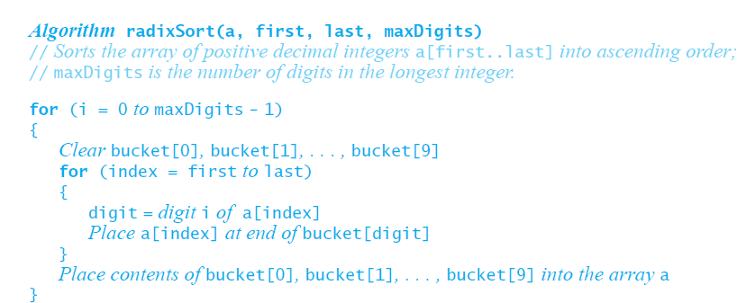
Algorithm

Slide 29
Time complexity
If there is a fixed number p of bucket sort stages (six stages in the case where the maximum value is 999999), then radix sort is O( n )
  There are p bucket sort stages, each taking O( n ) time
Strictly speaking, time complexity is
O( pn ), where p is the number of digits

Slide 30
About Radix sort
Note that only 10 buckets are needed regardless of number of stages since the buckets are reused at each stage
Radix sort can apply to words
  Set a limit to the number of letters in a word
  Use 27 buckets (or more, depending on the letters/characters allowed), one for each letter plus a “blank” character
  The word-length limit is exactly the number of bucket sort stages needed

Slide 31
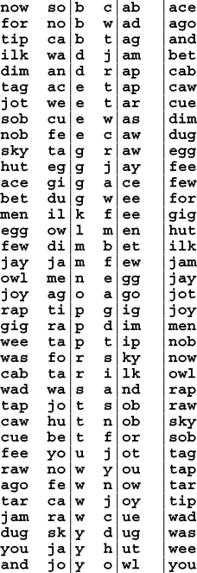
LSD Radix Sort
Like LSD Binary sort –
but on bigger chunks of the key.
We still need to count the number
of each type to figure out where
to move items in one pass
Runtime is still O(n).

Slide 32
Induction to the rescue!!!
base case:
  i=1. 0 digits are sorted (that wasn’t hard!)

Slide 33
Induction
Induction step
  assume for i, prove for i+1.
  consider two numbers: X, Y. Say X_{i} is i^{th} digit of X (from the right)
    X_{i+1} < Y_{i+1} then i+1th BinSort will put them in order
    X_{i+1} > Y_{i+1} , same thing
    X_{i+1} = Y_{i+1} , order depends on last i digits. Induction hypothesis says already sorted for these digits. (Careful about ensuring that your BinSort preserves order aka “stable”…)

Slide 34
RadixSorting Strings
1 Character can be BinSorted
Break strings into characters
Need to know length of biggest string (or calculate this on the fly).

Slide 35
Sort using Radix LSD
FAT, FIT, SIT, CAT, BAT, MET, COT, DOT, BIT

